Slide 1

CHILD MANAGEMENT SYSTEM
A comprehensive system to manage and track information about children in an organization.

Slide 2

INTRODUCTION
1
Comprehensive Child Management
2
Efficient Tracking
Efficiently track and monitor the progress and development of every child in your care. Our system provides tools to record attendance, track milestones, and document observations, ensuring that you have a comprehensive view of each child's growth and well-being.
Streamline the management of child data and records with our comprehensive Child Management System. Easily store and access important information about each child, including personal details, medical history, and emergency contacts.

Slide 3
MAIN MENU
1)CREATE CHILD RECORD - CREATING THE CHILD RECORD
2)ADD CHILD - ADDING CHILD DATA
3)VIEW CHILD - VIEWING THE CHILD RECORD
4)UPDATE CHILD RECORD - UPDATING THE INFORMATIONS OF CHILD RECORD
5)DELETE CHID RECORD - DELETING A SPECIFIC CHILD RECORD
6)GENERATE REPORT - GENERATING A REPOT ON CHILD’S DATA

Slide 4
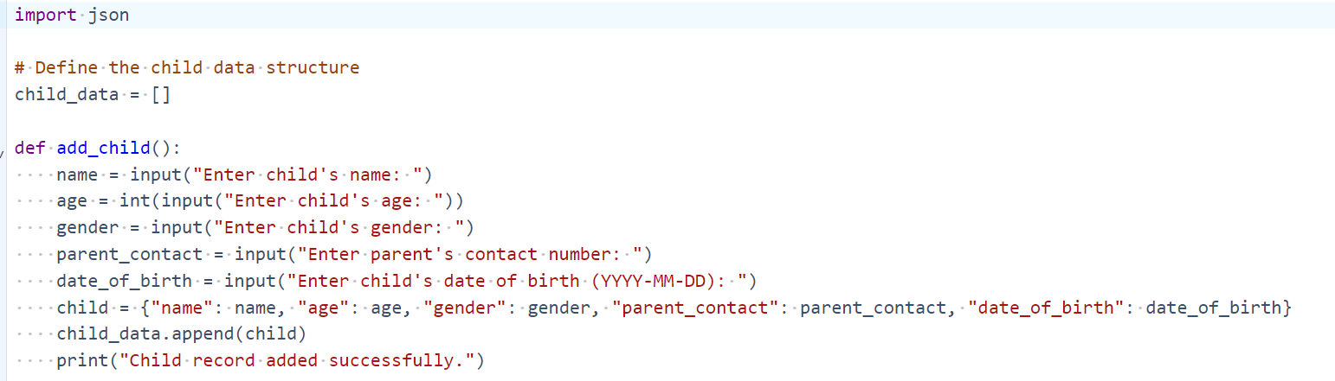
PROGRAM
ADD CHILD

Slide 5
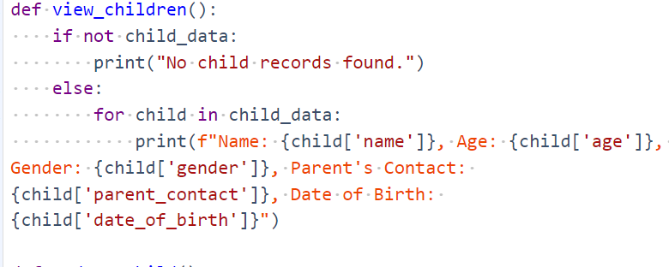
VIEW CHILD

Slide 6
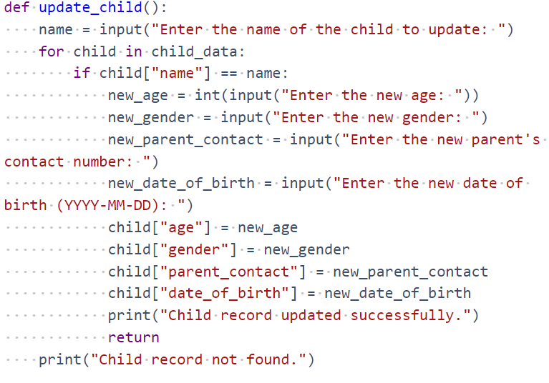
UPDATE CHILDREN

Slide 7
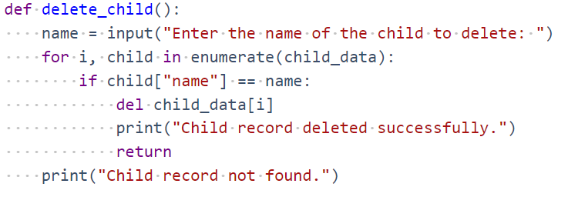
DELETE CHILD

Slide 8
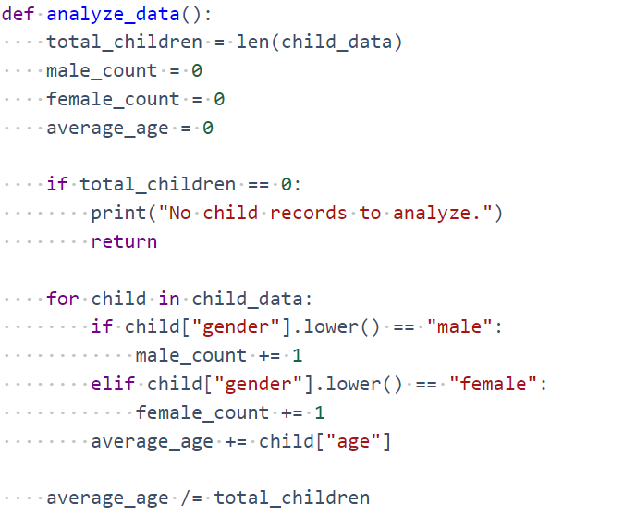
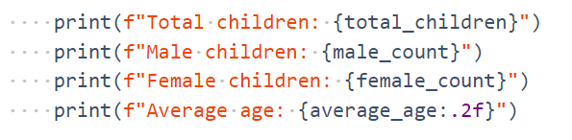
ANALYZE DATA

Slide 9
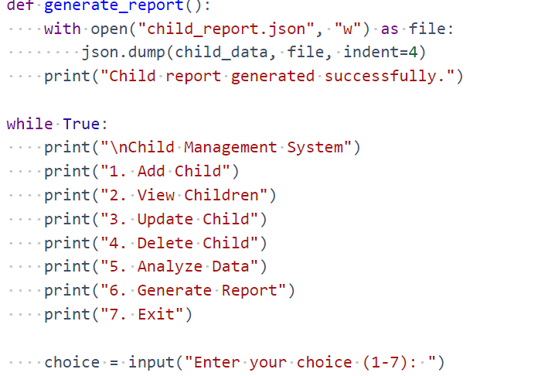
GENERATE REPORT

Slide 10
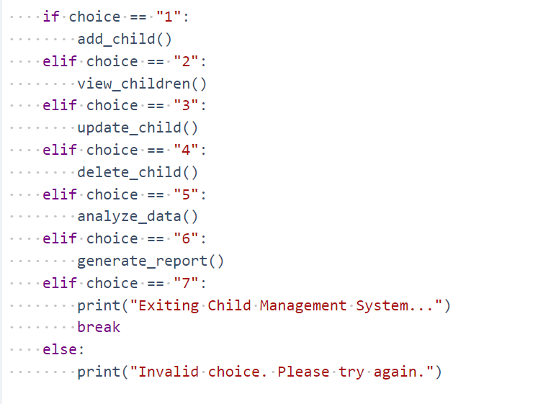

Slide 11
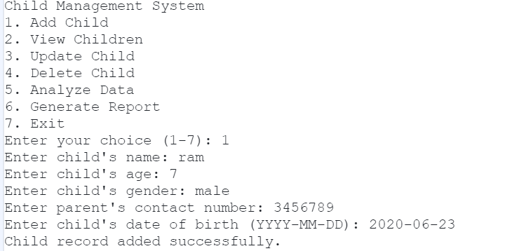
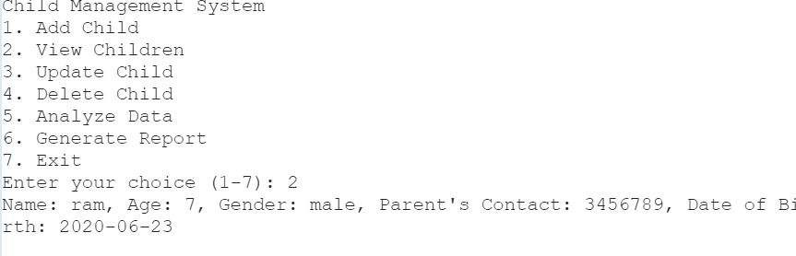

Slide 12
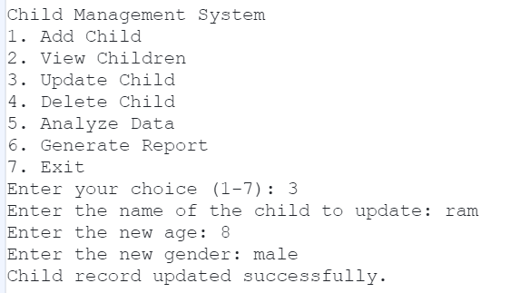
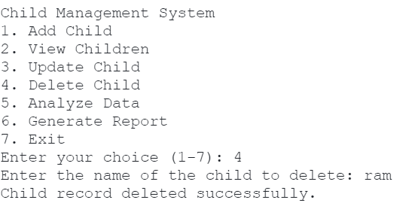

Slide 13
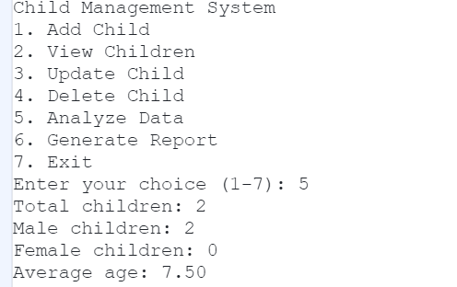
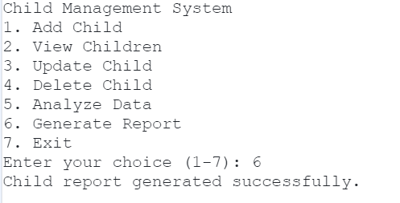

Slide 14
THANK YOU !!

